Slide 1


Gbolahan (GB) Oladeji
2023/07/24

Slide 2

Outline
Executive Summary
Introduction
Methodology
Results
Conclusion
Appendix

Slide 3
Executive Summary
We employ data science methodologies, including Data Collection, Exploratory Analysis, Visualization, and Machine Learning Modeling, to predict the likelihood of successful landings for the SpaceX Falcon9 first stage.
Notably, our findings indicate an increasing trend in successful landings over time due to advancements made during trials throughout the years. Further details to be discussed in subsequent slides.

Slide 4
Introduction
Project background and context
Space exploration is a costly venture that was previously only dominated by governmental agencies due to enormous funding requirements. However, new private options like SpaceX are disrupting the landscape by competing on technology efficiency, pricing, and faster delivery. Thereby providing more options and increased launch activities. For example, SpaceX as of 2013 was about $15mm cheaper than the nearest competitor[].
One of the key push by private enterprises as a business case is the ability to reuse the rocket, which if successful, would further lower the cost of rocket launch by an order of magnitude.
Problem To Solve:
With reuse being a key business strategy, we need to use data science to solve the challenge of achieving success launch rate as well as predict the likelihood of successful landing of the rocket ultimately leading to reuse.

Slide 5

Section 1

Slide 6
Methodology
Executive Summary
Data collection methodology:
Describe how data was collected
Perform data wrangling
Describe how data was processed
Perform exploratory data analysis (EDA) using visualization and SQL
Perform interactive visual analytics using Folium and Plotly Dash
Perform predictive analysis using classification models
How to build, tune, evaluate classification models

Slide 7
Data Collection
Describe how data sets were collected.
You need to present your data collection process use key phrases and flowcharts
The data were collected through various sources including:
(1) SpaceX REST API which is an open-source RESPI for launch, rocket, core, capsule, Starlink, launchpad, and landing pad data.
(2) Collection through Web scraping from the Wikipedia page containing the SpaceX launch data.
These would be discussed in detail in the next slide.

Slide 8
Data Collection – SpaceX API
Show on the right is the flowchart of the data collection via the SpaceX API
API:
https://api.spacexdata.com/v4/launches/past
Data Collection Notebook:
https://github.com/devtage-goladeji/ai-capstone/blob/main/spacex-data.ipynb
Task1: (Collection) Request & Parse the SpaceX launch data using Get Request
Task2: Filter the DataFrame to only include Falcon 9 launches
Task 3: (Wrangling) Deal with Missing Values (– fill via mean value)
Task 4: Save Data for further analysis

Slide 9
Data Collection - Scraping
With the process, the launch records were scraped from HTML in a Wikipedia:
https://en.wikipedia.org/w/index.php?title=List_of_Falcon_9_and_Falcon_Heavy_launches&oldid=1027686922
Notebook GitHub URL:
https://github.com/devtage-goladeji/ai-capstone/blob/main/jupyter-labs-webscraping.ipynb
CSV produced:
https://github.com/devtage-goladeji/ai-capstone/blob/main/spacex_web_scraped.csv
TASK 1: Request the Falcon9 Launch Wiki page from its URL via HTTP Get Method and BeautifulSoup object
Task2: Extract all column/variable names from the HTML table header using HTML tags with soup object
Task 3: Create a data frame by parsing the launch HTML tables
Task 4: Save Data for further analysis spacex_web_scraped.csv

Slide 10
Data Wrangling
Describe how data were processed
In the data wrangling process, we performed some exploratory data analysis to understand which data elements are labels and which are features. Also, the data were analyzed for quality assurance and issues such as missing values were addressed.
Key Tasks:
Notebook GitHub URL: https://github.com/devtage-goladeji/ai-capstone/blob/main/labs-jupyter-spacex-Data-wrangling.ipynb
Data Generated: https://github.com/devtage-goladeji/ai-capstone/blob/main/dataset_part_2.csv
1) Load Data dataset_part_1.csv
2) Identify & Calculate % of missing values
3) Identify numerical & categorical columns
4) Calculate # of launches per site
5) Calculate # & occurrence of each orbit
6) Calculate # & occurrence of orbits mission outcomes
7) Create Landing Outcome label
8) Export/save result data

Slide 11
EDA with Data Visualization
Summarize what charts were plotted and why you used those charts
EDA visualization Notebook GitHub URL: https://github.com/devtage-goladeji/ai-capstone/blob/main/IBM-DS0321EN-SkillsNetwork_labs_module_2_jupyter-labs-eda-dataviz.ipynb.jupyterlite.ipynb Data Generated: https://github.com/devtage-goladeji/ai-capstone/blob/main/dataset_part_3.csv
Charts | Rationale
Scatter Plot – Flight Number vs Payload Mass | How continuous launch attempt & payload variables affects launch outcome. Appears the more the payload, the less successful the launch
Scatter Plot – flight Number vs Launch Site | Visualize the relationship between Flight Number and Launch Site – and see if the success rate is tied to the launch site. We see that CCCAFS LC-40 has a higher success rate, but equally more launches as well.
Scatter Plot – Payload Mass vs Launch Site | Visualize the relationship between Payload and Launch Site – No rocket was launched for heavy payload at VAFB-SLC launch site. Also, success outcome was more within less heavy payload (less than 7000kg)
Bar Chart – Orbit Type vs Class Mean | Visualize the relationship between the success rate of each orbit type. Here we can see that ES-L1, GEO, HEO, and SSO had higher success rates than other orbit types.
Scatter Plot – flight Number vs Orbit | Here we also see that LEO success appears inversely correlated to the number of flights, however no such relationship with GTO which has success across all flight numbers.
Scatter Plot - Payload Mas vs Orbit | Find the relationship between payload mass and orbit. The relationship is a mixed bag; Heavy payload success is more seen for VLEO, but for GTO, both heavy payload success and failures are recorded
Line graph – Year vs Success rate | Visualize the launch success yearly trend – we see from the trend the increasing success rate as the years progress.

Slide 12
EDA with SQL
Using bullet point format, summarize the SQL queries you performed
Select Distinct Launch Site
Display 5 records where launch sites begin with ‘CCA’
Display the total payload mass carried by boosters launched by NASA (CRS)
Display average payload mass carried by booster version F9 v1.1
List the date when the first successful landing outcome in the ground pad was achieved
List the names of the boosters with success in drone ship and with payload mass > 4000 and < 6000
List the total number of successful and failed mission outcomes
List names of the booster version which have carried maximum payload mass.
List records with drone failure landing outcomes in 2015
Rank landing outcomes (failure or success) between 2010/06/04 and 2017/03/20 in descending order
EDA SQL Notebook GitHub URL:
https://github.com/devtage-goladeji/ai-capstone/blob/main/jupyter-labs-eda-sql-coursera_sqllite.ipynb

Slide 13
Build an Interactive Map with Folium
Summary of map objects created & added:
Folium.Circle object for the launch sites
Folio.MarkerCluster as a container for the Folio.Marker
Folium.Icon
Folium.Marker
Folium.PolyLine –
Rationale:
Objects were added to provide visual clarity and interpretation to map related data. For example, the color for the launch outcome helps put into perspective, the success/failure of each launch within each launch site.
Notebook GitHub URL: https://github.com/devtage-goladeji/ai-capstone/blob/main/IBM-DS0321EN-SkillsNetwork_labs_module_3_lab_jupyter_launch_site_location.jupyterlite.ipynb

Slide 14
Build a Dashboard with Plotly Dash
As part of the exploratory data visualization effort, the following were added during the exercise:
Dropdown list for Launch site selection (providing data slices via point and click)
Pie chart – provide a breakdown of launch sites # of launches and outcomes
Slider to filter the payload
Scatter diagram to show a correlation between payload and launch success s/ outcomes
Callbacks to respond to click events for pie charts and the payload slider/scatter diagram
Explain why you added those plots and interactions:
Notebook GitHub URL: https://github.com/devtage-goladeji/ai-capstone/blob/main/spacex_dash_app.py

Slide 15
Predictive Analysis (Classification)
The following is the summary of the model development process in arriving at the best classification model: Build the machine learning pipeline:
Data Preprocessing: Profile data, handle missing values using advanced techniques, apply suitable encoding for categorical data, and consider different feature scaling methods (used standardization classifier here).
Train-Test Split: Divide data into training and testing sets; use cross-validation to improve generalization and avoid overfitting.
Hyperparameter Tuning: Utilize GridSearchCV to find optimal hyperparameters. Used different estimators including LogisticRegression, SVM, DecisionTree, KNN
Model Selection: Evaluate models using various metrics; choose the best-performing model for deployment.
Interpretability: Use interpretable models like linear regression or decision trees.
Model Deployment: Thoroughly test the model with real-world data before deploying it.
Continuous Improvement: Iterate and refine the process to enhance model accuracy and robustness over time.
Notebook GitHub URL: https://github.com/devtage-goladeji/ai-capstone/blob/main/IBM-DS0321EN-SkillsNetwork_labs_module_4_SpaceX_Machine_Learning_Prediction_Part_5.jupyterlite.ipynb
Data Preprocessing
Train Test Split
Train | GridSearchCV
Scoring / Deployment

Slide 16
Results
Exploratory data analysis results
Interactive analytics demo in screenshots
Predictive analysis results

Slide 17

Section 2

Slide 18
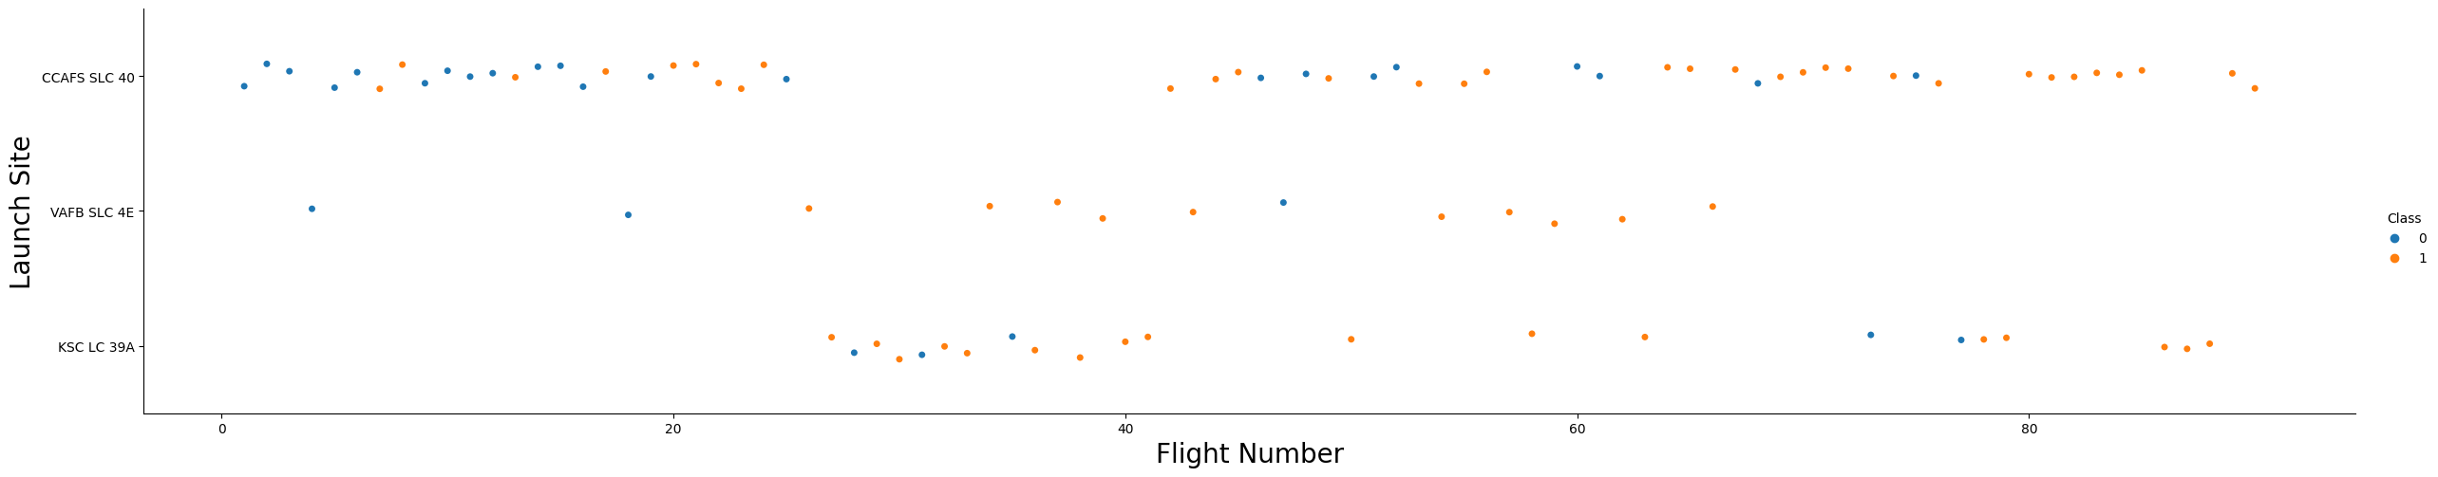
Flight Number vs. Launch Site
VAFB SLC 4E had fewer launches and fewer positive outcomes compared to the other 2 launch sites. Also, it appears further subsequent launches were prioritized for both CCAFS SLC 40 and KSC LC 39A

Slide 19
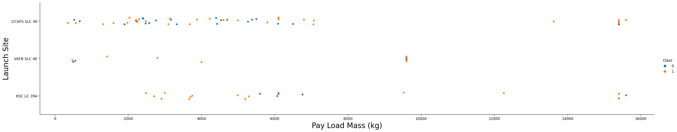
Payload vs. Launch Site
Shows a scatter plot of Payload vs. Launch Site
It can be observed that the Launch sites CCAPFS SLC 40 & KSC LC39A appear to have better success outcomes for heavy payload than the rest.

Slide 20
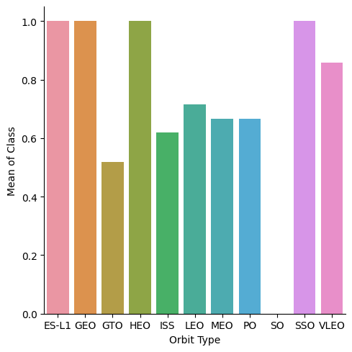
Success Rate vs. Orbit Type
Shows a bar chart for the success rate of each orbit type
More successful outcome can be observed for E-L1, GEO, HEO, SSO and VLEO

Slide 21
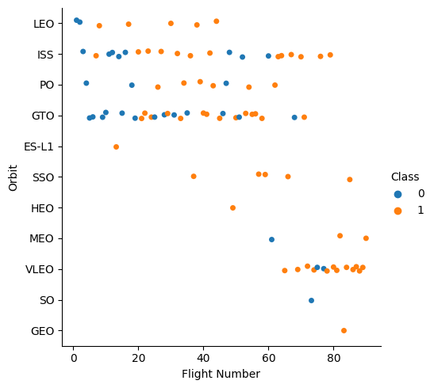
Flight Number vs. Orbit Type
Shows a scatter point of Flight number vs. Orbit type
From the observation, in the LEO orbit, the Success appears related to the number of (early) flights; on the other hand, there seems to be no relationship between flight number when in GTO orbit.

Slide 22
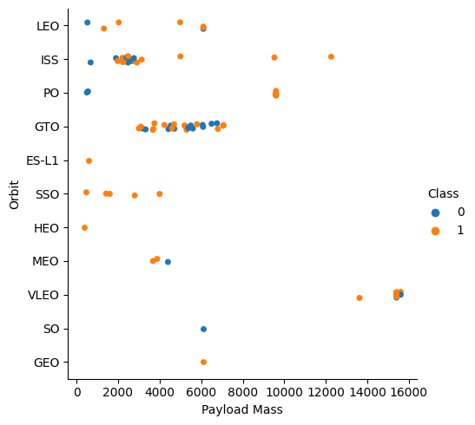
Payload vs. Orbit Type
Shows a scatter point of payload vs. orbit type
LEO had success on the opposite end of the loads
ISS had many successful outcomes in the 500 to 2500 payload range.
PO only had success with lower payloads
VLEO seems to be the only orbit with higher heavy-load (16,000kg) success
However, for GTO we cannot distinguish this well as both a positive landing rate and a negative landing(unsuccessful mission).

Slide 23
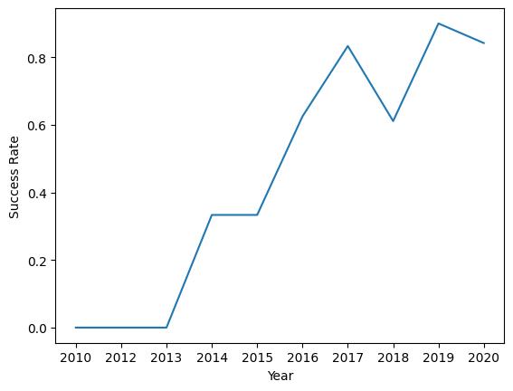
Launch Success Yearly Trend
Shows a line chart of the yearly average success rate
It can be observed that there is an increasing trend of successful outcome apar from the dip in 2018

Slide 24
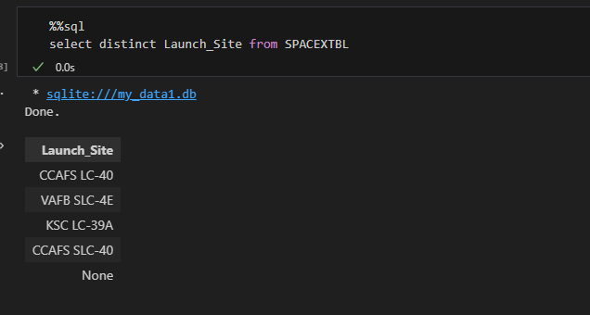
All Launch Site Names
Finds the names of the unique launch sites

Slide 25
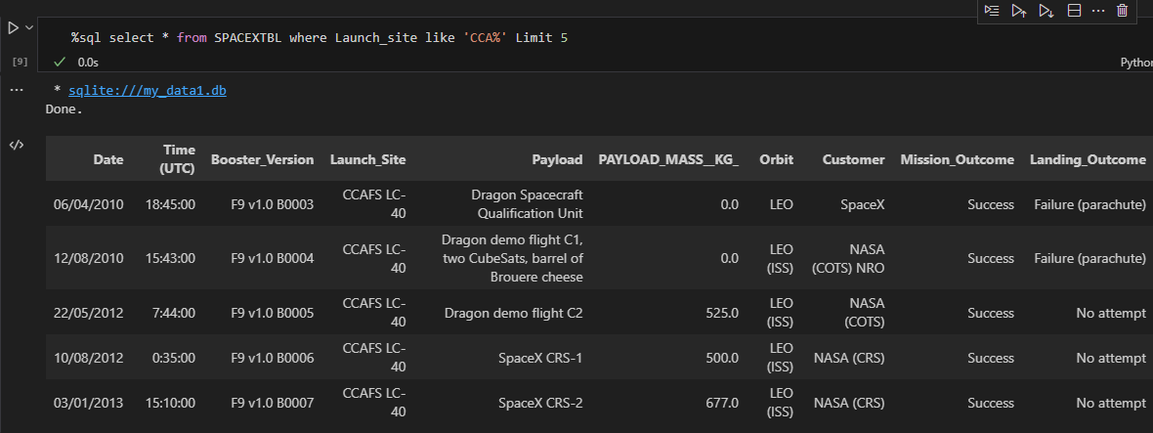
Launch Site Names Begin with 'CCA'
Find 5 records where launch sites begin with `CCA`

Slide 26
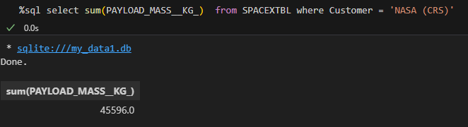
Total Payload Mass
Calculates the total payload carried by boosters from NASA

Slide 27
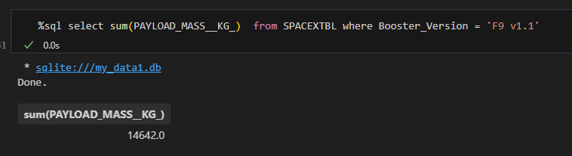
Average Payload Mass by F9 v1.1
Calculates the average payload mass carried by booster version F9 v1.1

Slide 28
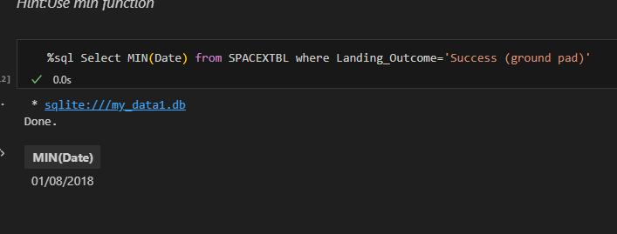
First Successful Ground Landing Date
Finds the dates of the first successful landing outcome on ground pad

Slide 29
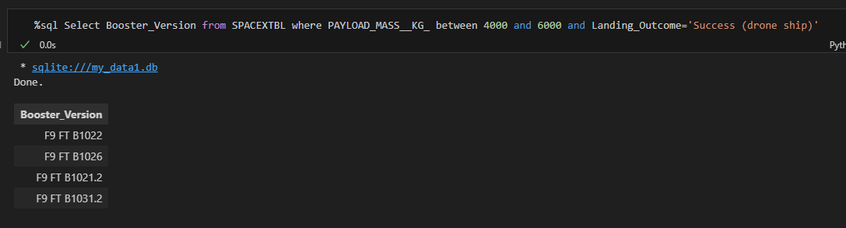
Successful Drone Ship Landing with Payload between 4000 and 6000
Lists the names of boosters that have successfully landed on drone ship and had payload mass greater than 4000 but less than 6000

Slide 30
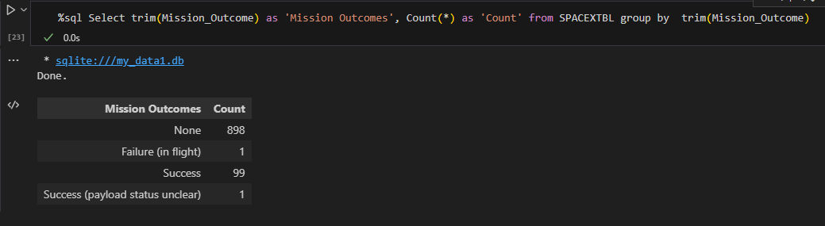
Total Number of Successful and Failure Mission Outcomes
Calculates the total number of successful and failure mission outcomes

Slide 31
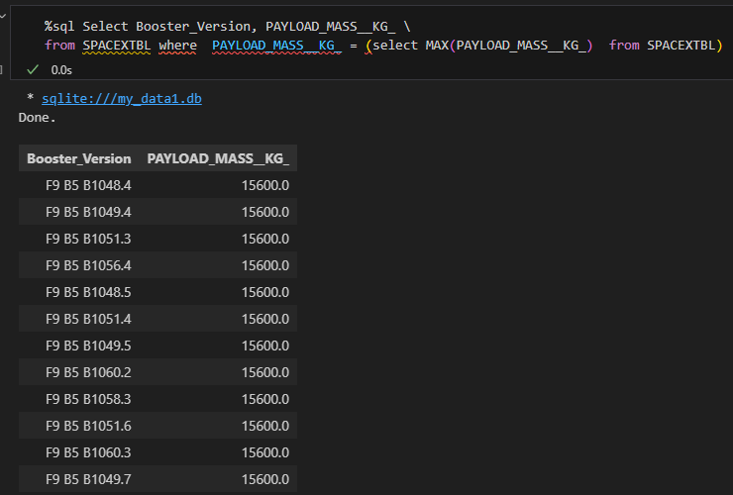
Boosters Carried Maximum Payload
Lists the names of the booster which have carried the maximum payload mass

Slide 32
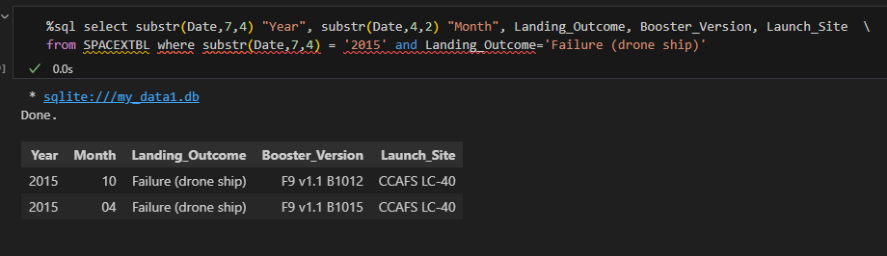
2015 Launch Records
Lists the failed landing_outcomes in drone ship, their booster versions, and launch site names for in year 2015

Slide 33
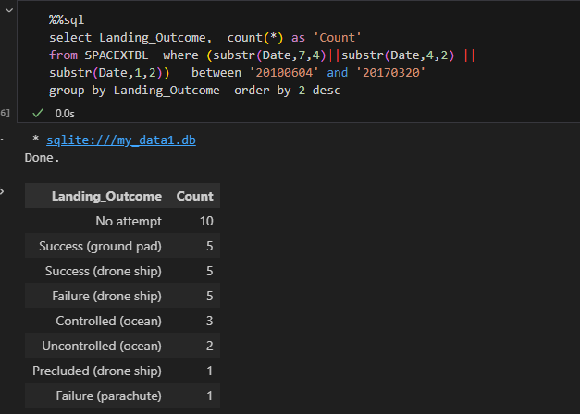
Rank Landing Outcomes Between 2010-06-04 and 2017-03-20
Ranks the count of landing outcomes (such as Failure (drone ship) or Success (ground pad)) between the date 2010-06-04 and 2017-03-20, in descending order

Slide 34

Section 3

Slide 35
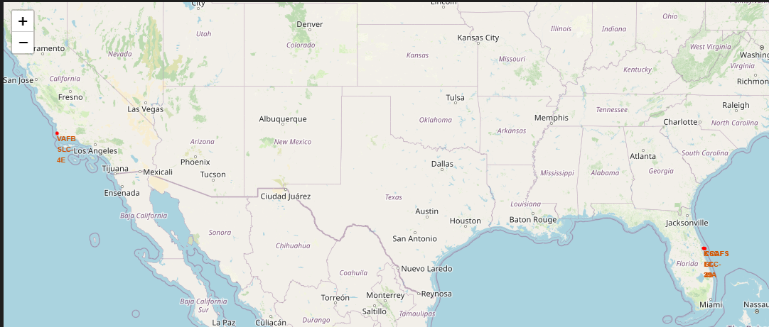
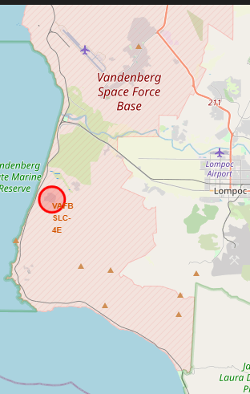
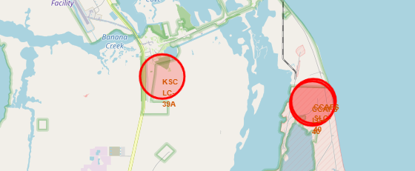
All Launch Sites Map
1
The map [1] shows the 4 launch sites. It is observed that the launch sites are located close to the coastal waters. One of the sites (VAFB SLC-4E) is on the west coast (Los Angeles) and the remaining 3 (KSC LC-39A, CCAFS LC-40, CCAFS SLC-40 ) are on the east coast (Florida) and in proximity.

Slide 36
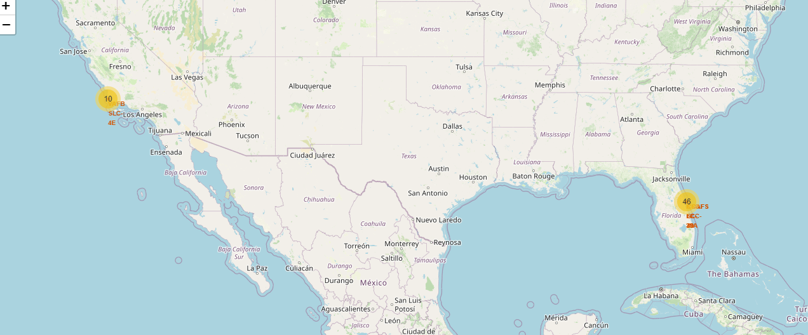
Launch Sites Outcomes Map / 2
The map shows launch sites and the number of launches per each site: 10 launches in the Los Angeles area and 46 launches in the Florida area. A drill-down of the outcomes will be presented in the next slide….

Slide 37
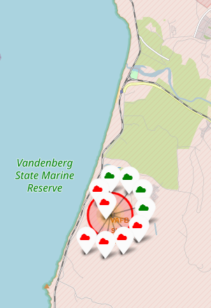
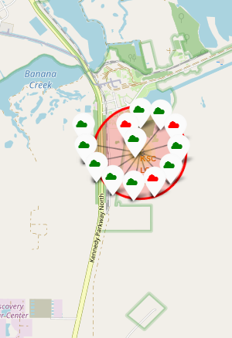
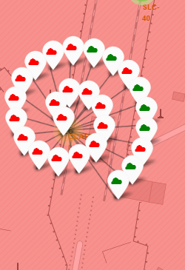
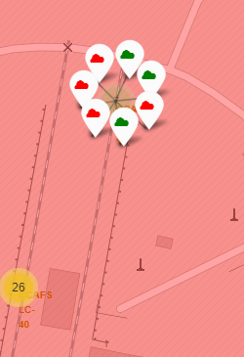
Launch Sites Outcomes Map
1
2
3
4
This map shows the launch outcomes icons (success = green | failure = red)
[1] VAFB SLC-4E - 10 launches (6 failures, 4 successes) [2] KSC LC-39A - 13 launches (3 failures, 8 successes) [3] CCAFS LC-40 - 26 launches (19 failures, 7 successes) [4] CCAFS SLC-40 – 7 launches (4 failures, 3 successes)

Slide 38
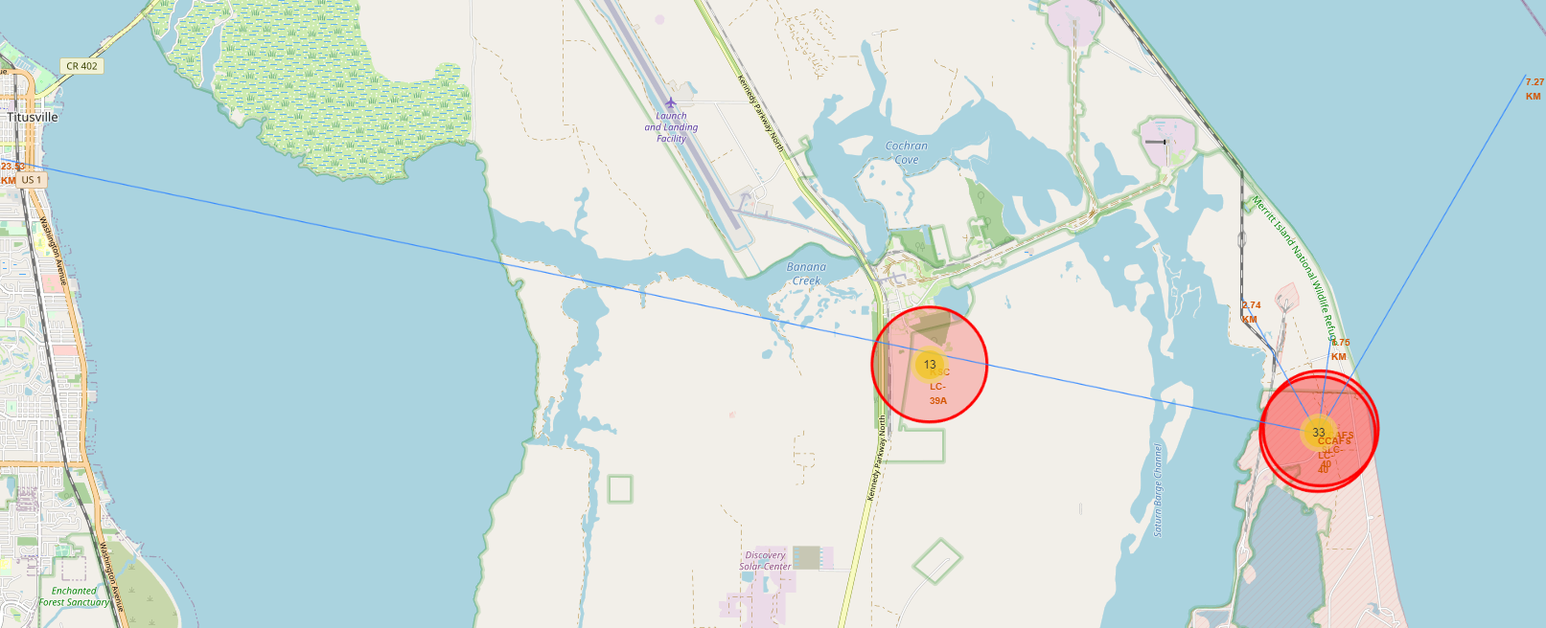
CCAFS LC-40 Launch Site & Distance To Specific Landmarks
4
1
2
3
[1] Titusville City (23.53km) [2] Railway line (2.74km) [3] Samuel C Philips Parkway (1.75KM) [4] Florida Coastline (7.27KM)
One of the key observations is the proximity of the site to infrastructures & water, but a safe distance from settlements

Slide 39

Section 4

Slide 40
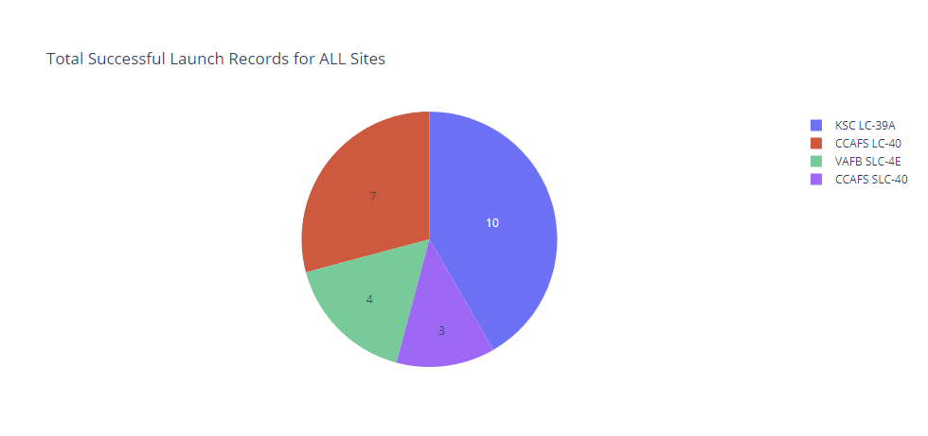
Launch Sites Successful Launch Counts
KSC LC-39A and CCAFS LC-40 launch sites have more successful launch counts (10 and 7 respectively) than the remaining 2.

Slide 41
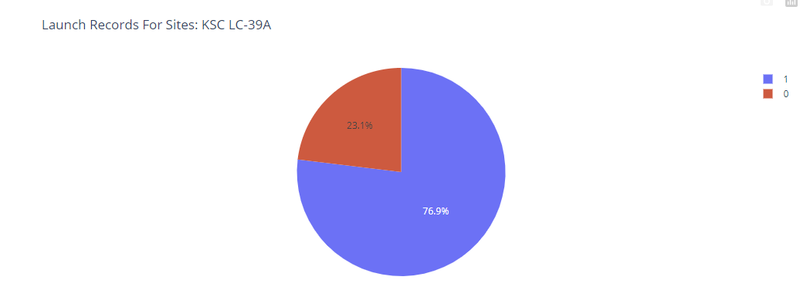
KSC LC-39A Launch Sites Outcome Counts
KSC LC-39A has the highest success ratio based on the % a well as the count

Slide 42
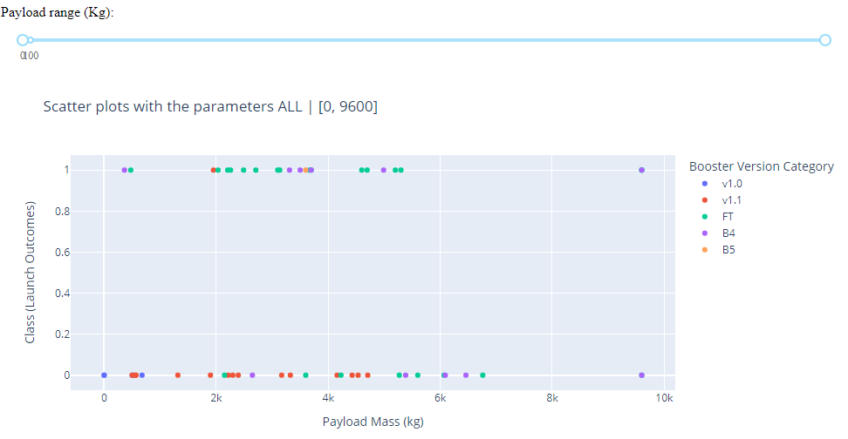
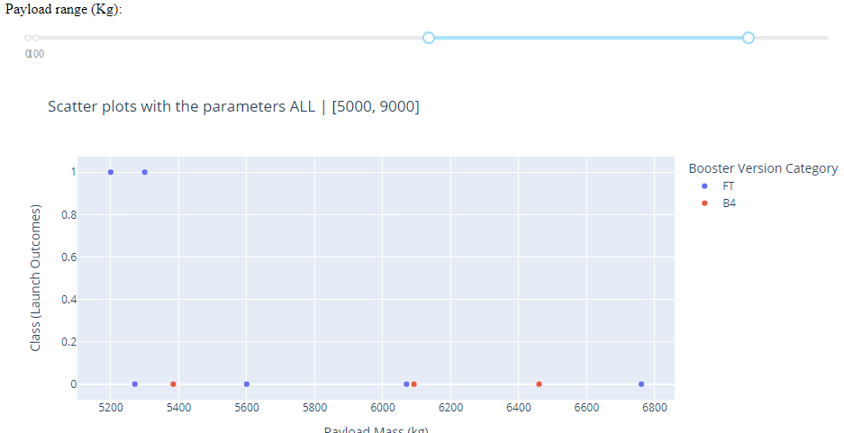
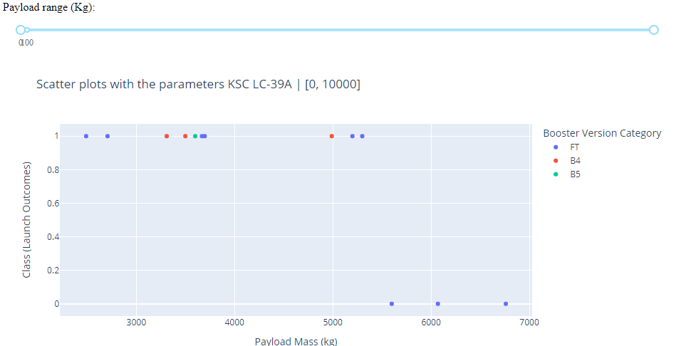
Payload vs. Launch Outcome With Payload Ranges
1
2
3
Notes:
[1] All Sites and payload range [2] – Only FT & B4 booster version categories are within the 5000 to 9000 payloads [3] For the site with the highest success rate, it is observed that successful launches happen at payloads lower than 5500kg. Payloads above 5000kg all failed.

Slide 43

Section 5

Slide 44
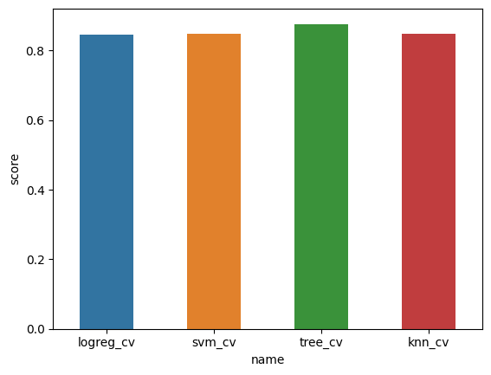
Classification Accuracy
From the diagram, tree_cv is the model with the highest classification accuracy.

Slide 45

Confusion Matrix – tree_cv
The tree_cv confusion matrix shows 100% accuracy in predicting success outcomes. However, for the failure outcome, the accuracy was 50%. Which means we have a 50% false negative.

Slide 46
Conclusions
Increasing Reusability: Over the years, we have observed a consistent upward trend in the rate of reusability, indicating progress in our efforts to reuse space launch vehicles effectively.
Challenges in Payload Landing: Despite advancements, successfully landing heavier payloads remains a significant challenge. Further research and development are needed to address this issue.
Data Science for Improved Landing Success: Leveraging data science, particularly the tree_cv technique, we can significantly enhance the likelihood of successful landings. Our predictive model demonstrates an 83% accuracy rate, showing promising results for future missions.
Continuous Improvement and Assessment: While our current model shows promise, it is crucial to continuously gather more data and monitor the model's performance over time. Regular assessments will help identify potential degradation and ensure that the model maintains the highest level of accuracy as our dataset grows.…

Slide 47
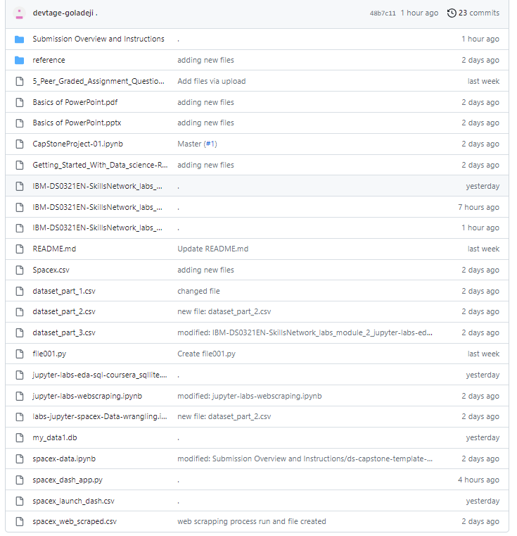
Appendix

Slide 48
References
[1] - SpaceX Challenge Has Arianespace Rethinking Pricing Policies – SpaceNews
[2] - Space launch market competition – Wikipedia
[3] – https://en.wikipedia.org/wiki/Space_launch_market_competition
[4] -

Slide 49


